Slide 1
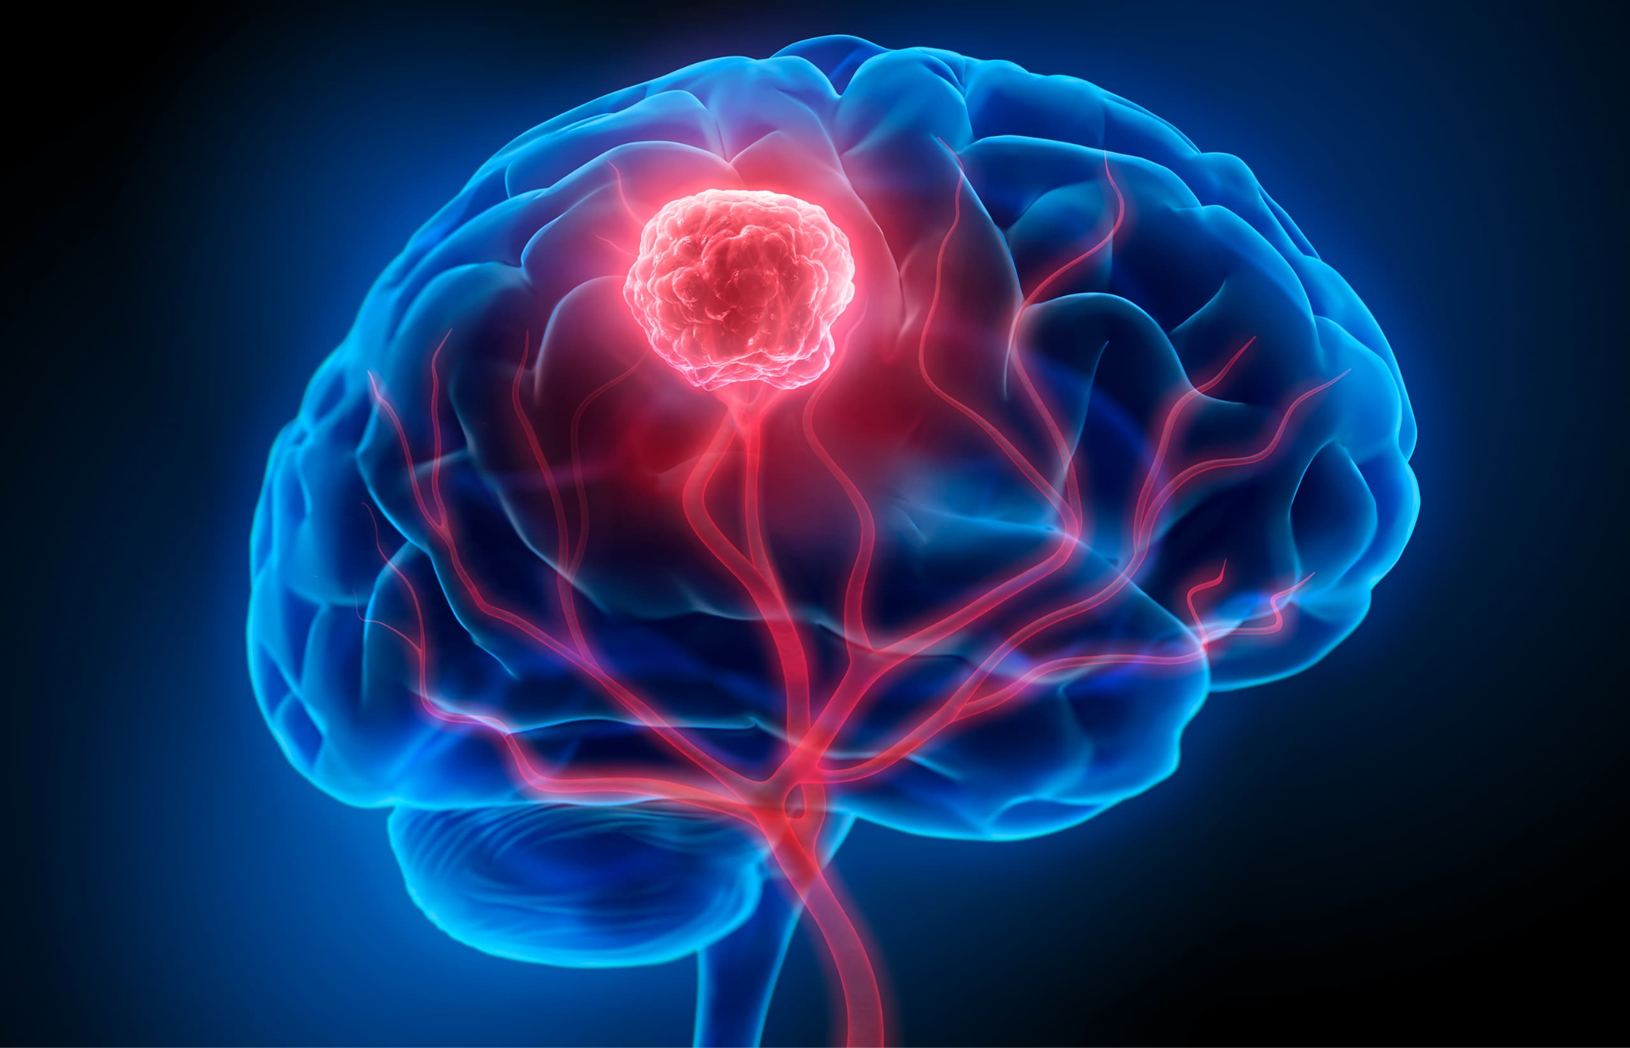
Predicting Brain Tumor Characteristics with Machine Learning
Jack and Chelsea
Fall, 2025

Slide 2
We aim to predict tumor histology using clinical patient data.
We are also splitting the dataset to look at the accuracy of predictions for small, medium, and large tumors.

Slide 3
Why Does This Matter?
Being able to classify brain tumors by histology (the type of tumor) is necessary to properly treat patients.
Seeing if there is a difference between brain tumor sizes in the predictability is important, because there could be value in using this method of classification for one or two of the groups, but this could be masked by the poor performance of the other group(s).

Slide 4
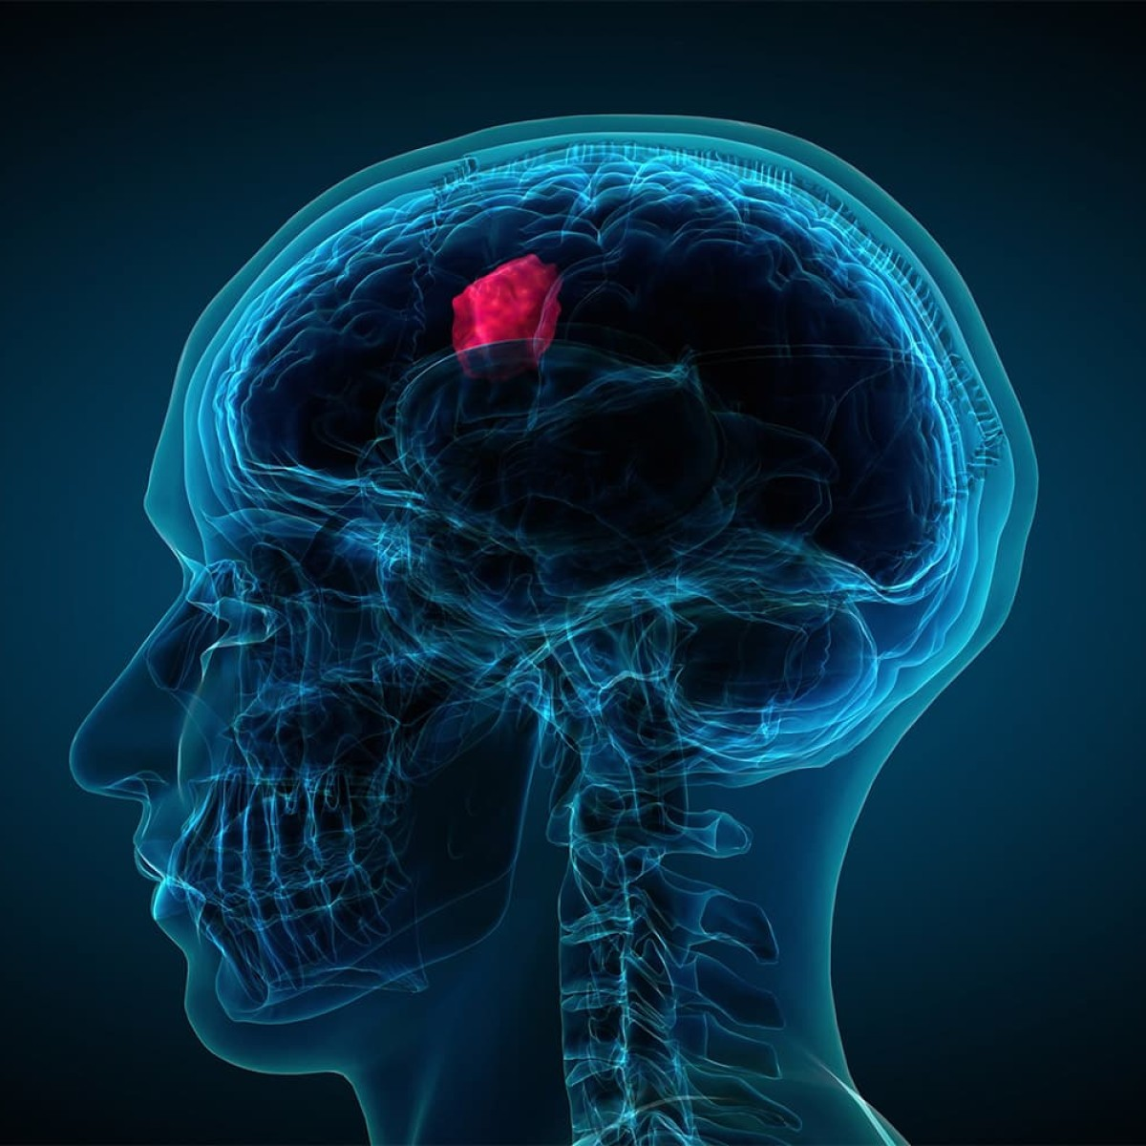
Dataset
Key Statistics:
14 categorical variables: Histology, Tumor Type, Location, Grade, Gender, etc.
4 numerical variables: Size (cm), Patient Age, Survival Rate, Growth Rate
20,000 observations

Slide 5
Relevant Literature
Other projects have used this dataset for different purposes including predicting survival rate, tumor location, and malignancy, as well as determining the treatments which maximize patient survival.
We used their results as benchmarks for what we expected to see.

Slide 6
MRI-Based Brain Tumor Classification Using Ensemble of Deep Features and Machine Learning Classifiers
- Kang, Ullah, and Gwak, 2021
“In our proposed framework, we adopt the concept of transfer learning and uses several pre-trained deep convolutional neural networks to extract deep features from brain magnetic resonance (MR) images. The extracted deep features are then evaluated by several machine learning classifiers. The top three deep features which perform well on several machine learning classifiers are selected and concatenated as an ensemble of deep features which is then fed into several machine learning classifiers to predict the final output.”

Slide 7
Feature extraction from MRI ADC images for brain tumor classification using machine learning techniques
- Vijithananda et al., 2022
“This study focuses on extracting demographic and texture features from MRI Apparent Diffusion Coefficient (ADC) images of human brain tumors, identifying the distribution patterns of each feature and applying Machine Learning (ML) techniques to differentiate malignant from benign brain tumors.”

Slide 8

Cleaning and Preprocessing
Dropped features:
We removed the variable Patient ID as it was irrelevant
We also removed Survival Rate and Follow Up Required, as we felt they were possible data leaks
Categorical encoding with OneHotEncoder
Feature scaling with MinMaxScaler
The dataset was very clean when we found it (no missing values)

Slide 9
Models & Methods
Classification:
Algorithm: RandomForestClassifier
Justification: robust to outliers, handles mixed data, interpretable
Key hyperparameters (depth, estimators, min samples per leaf, etc.)
Feature importance:
We tried to drop irrelevant features, but our accuracy only slightly improved
We tried to stratify the data by the top feature, however our accuracy became slightly worse
Stratification:
We straified the dataset by tumor size and compare accuracies

Slide 10
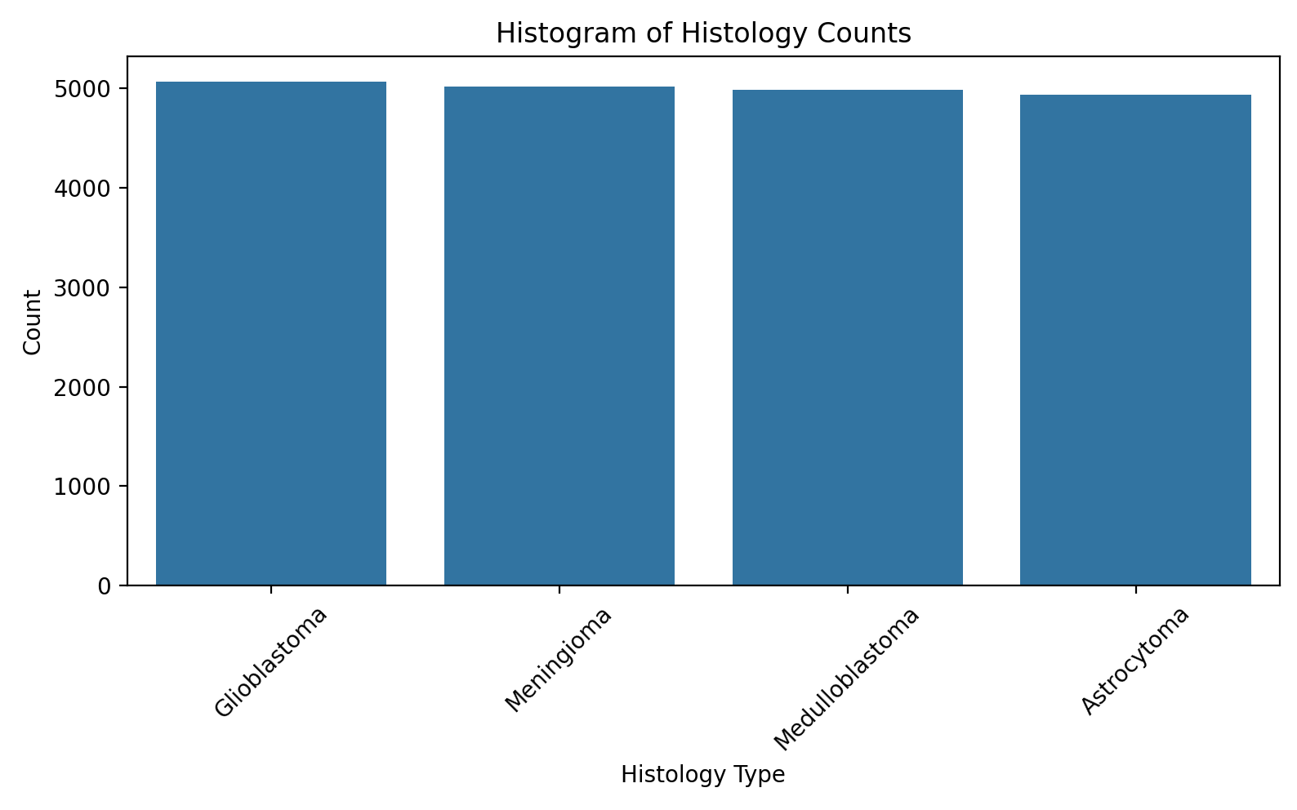

Slide 11
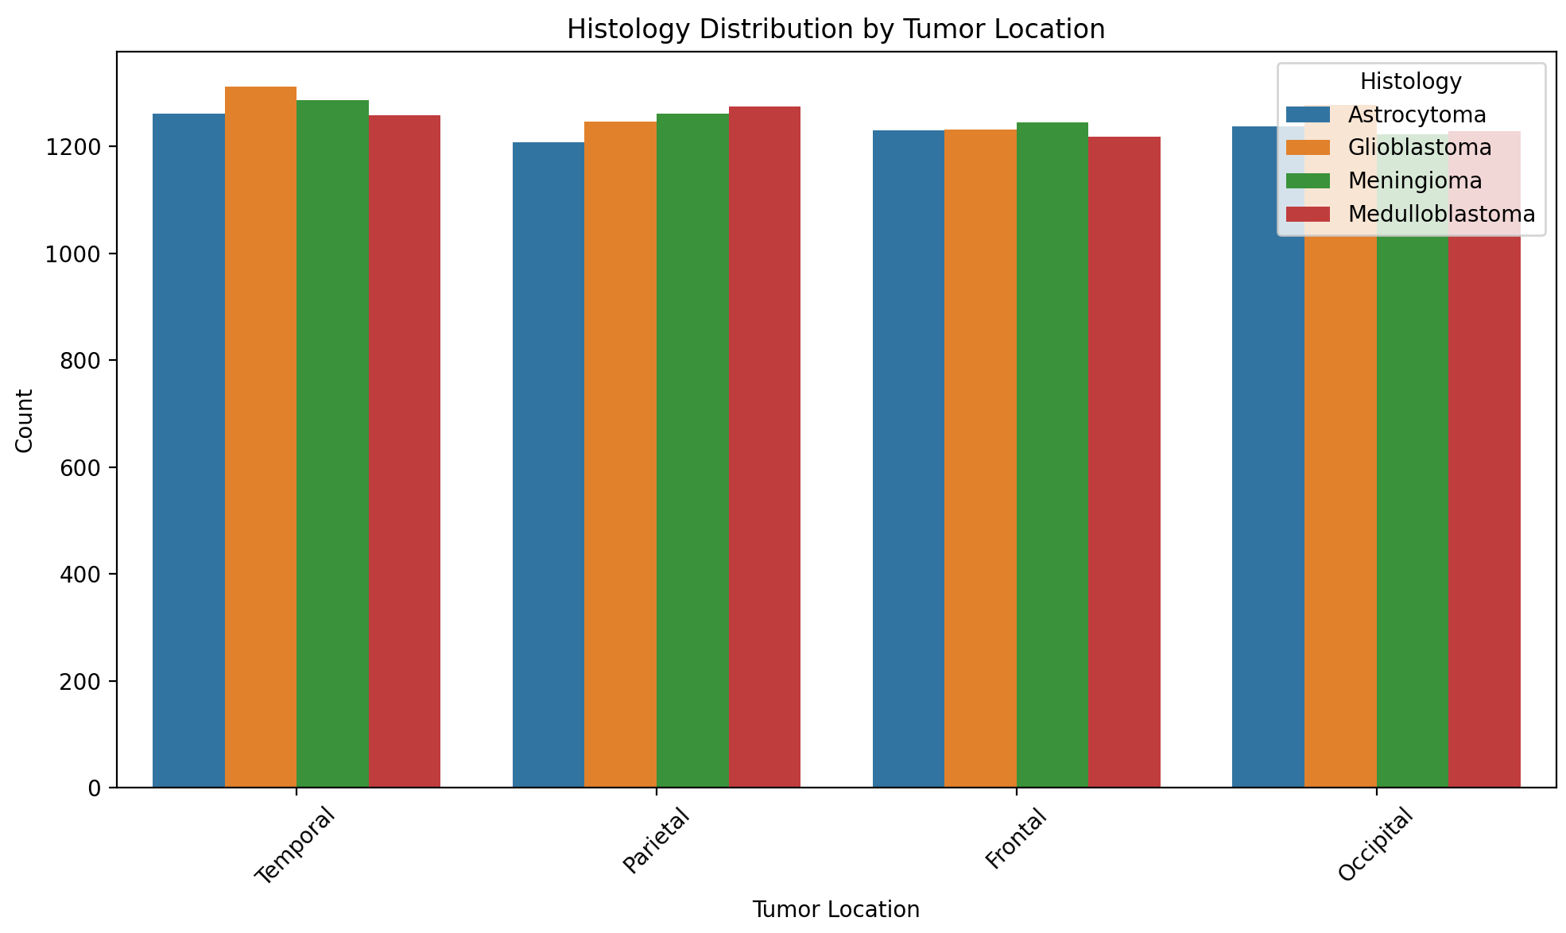

Slide 12
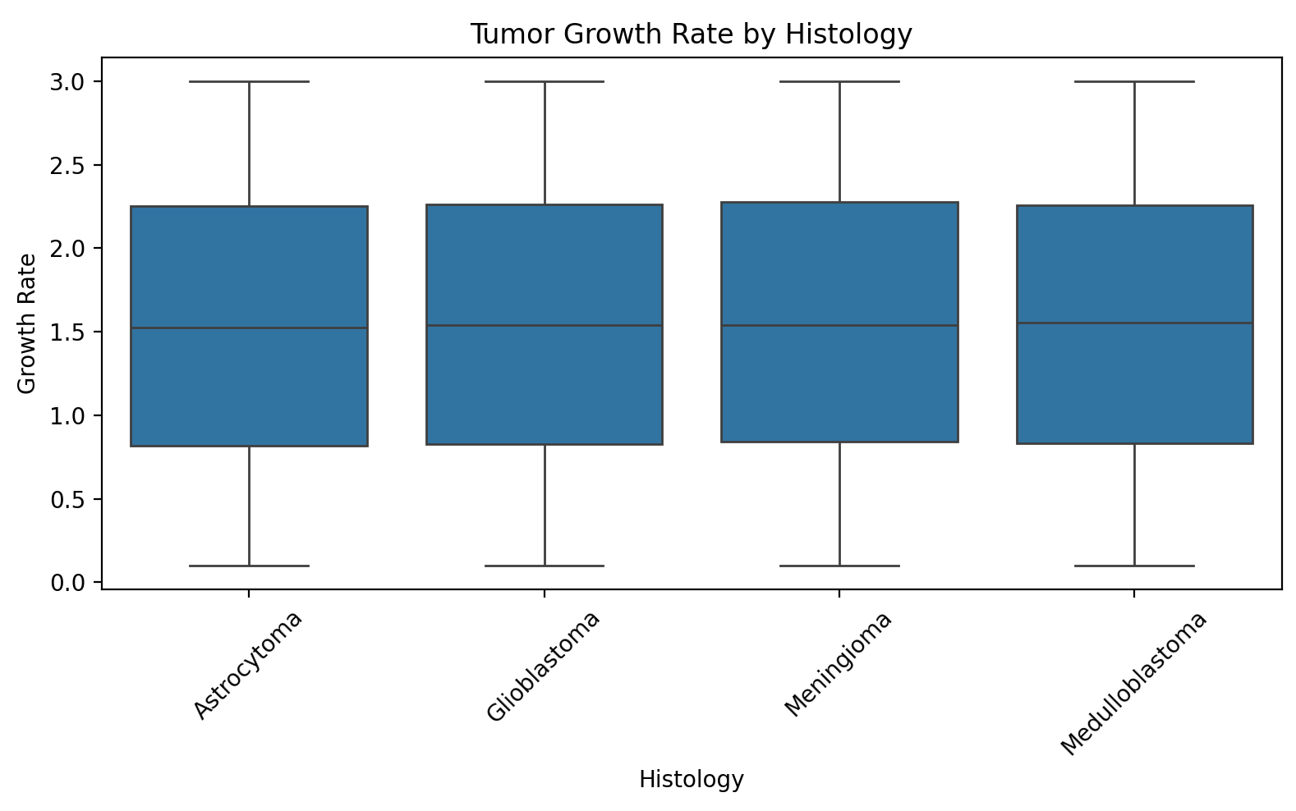
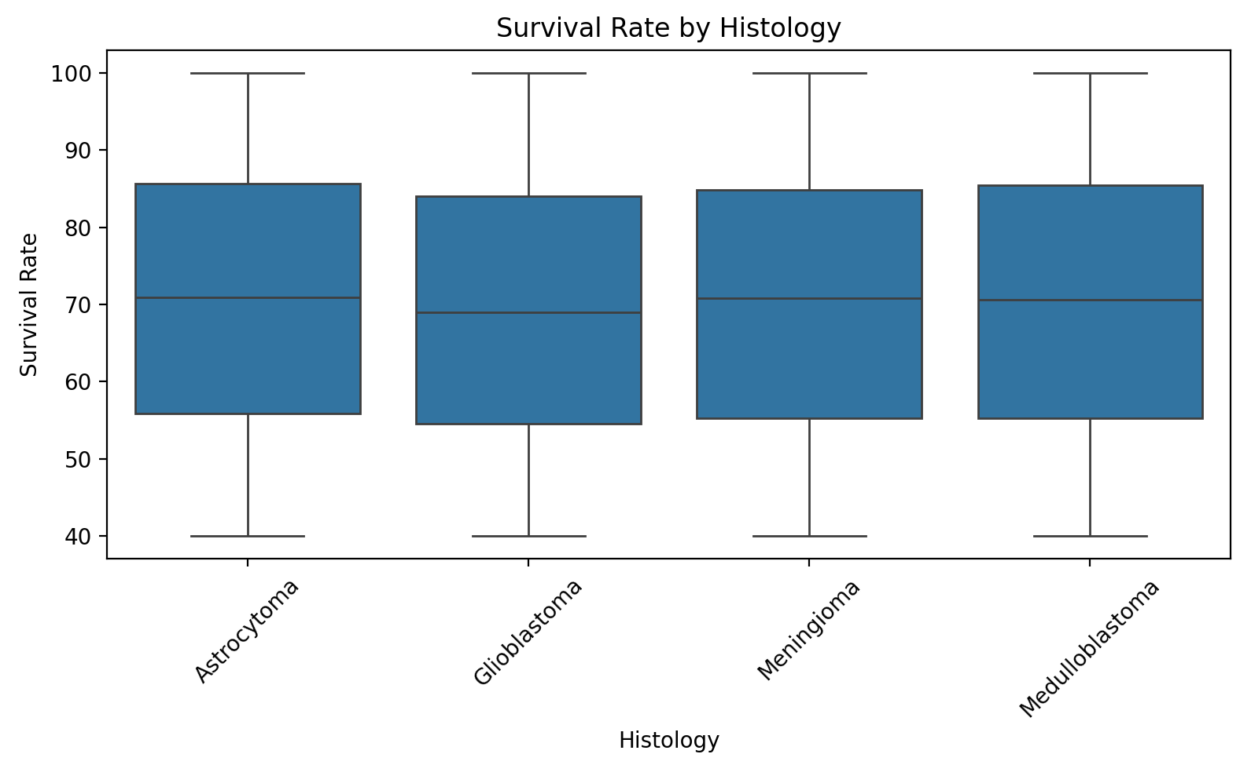
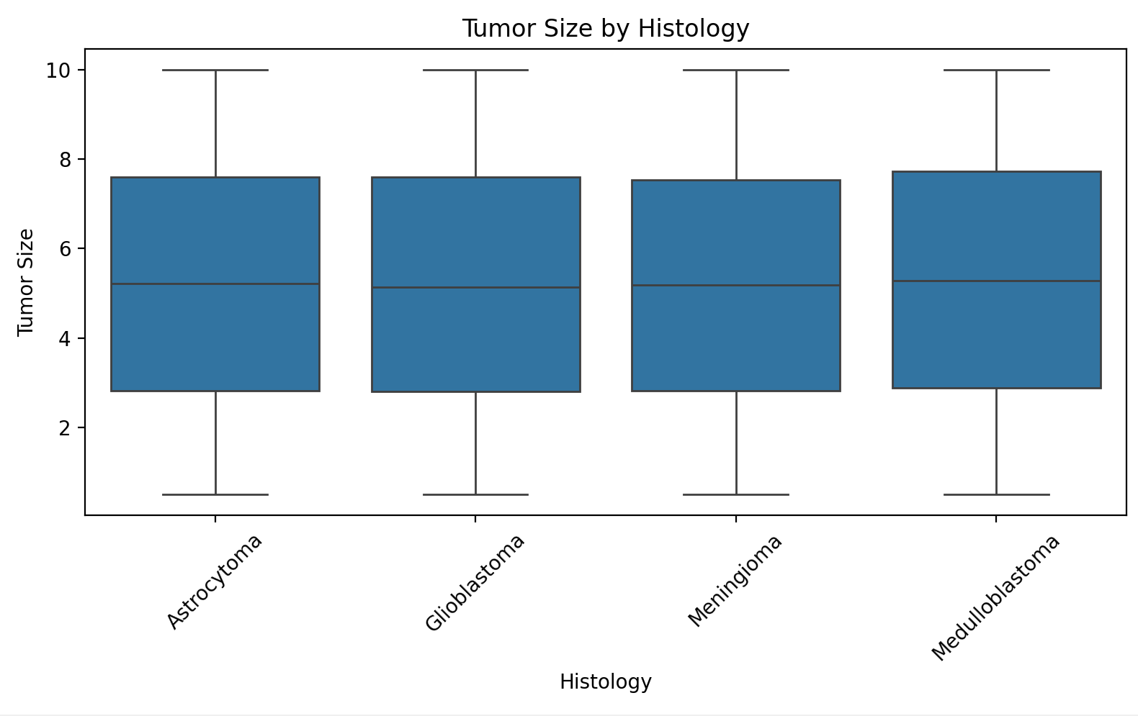

Slide 13
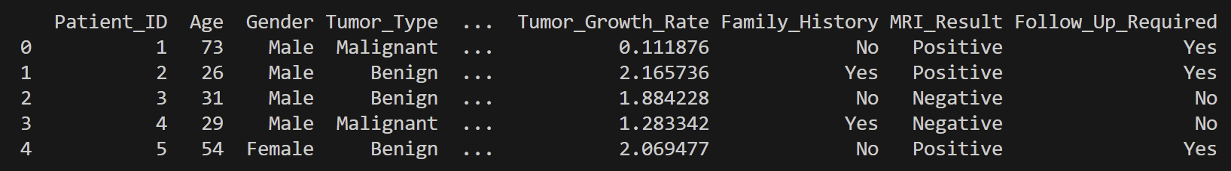
Summary Tables
df.head()

Slide 14
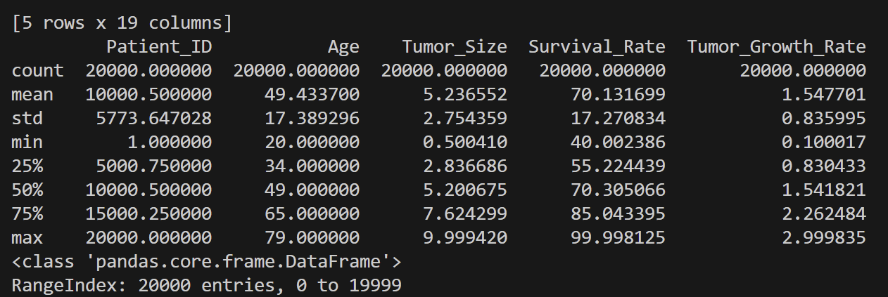
Summary Tables
df.describe()

Slide 15
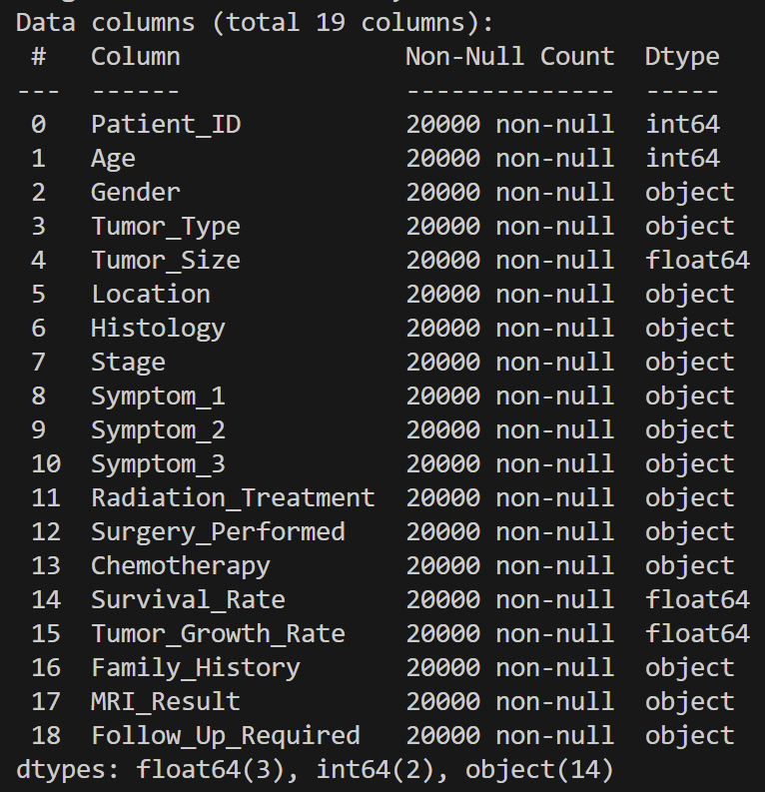
Summary Tables
df.info()

Slide 16
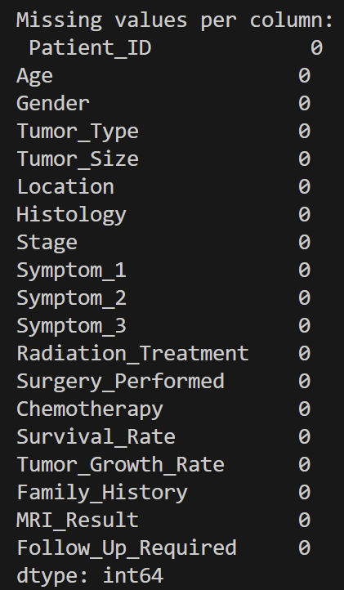
Missing Values
df.isnull().sum()

Slide 17
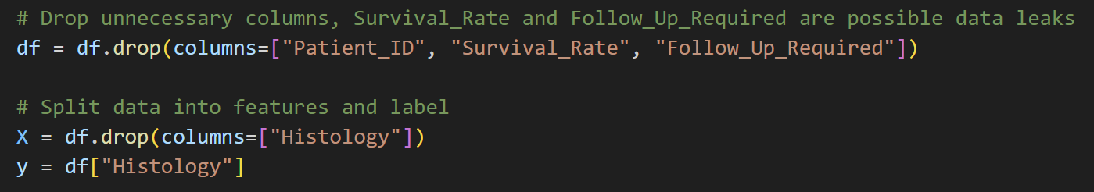
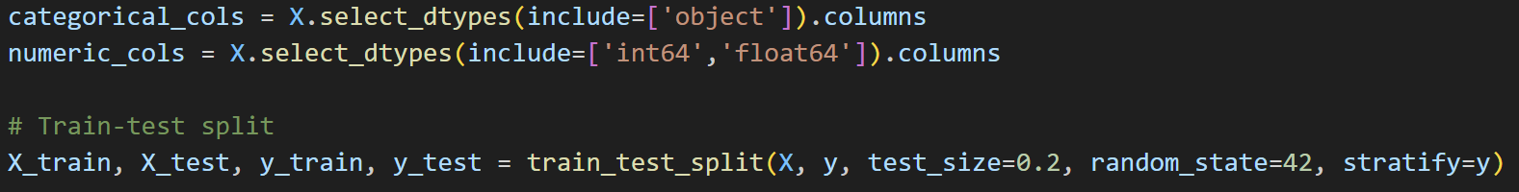
Code

Slide 18
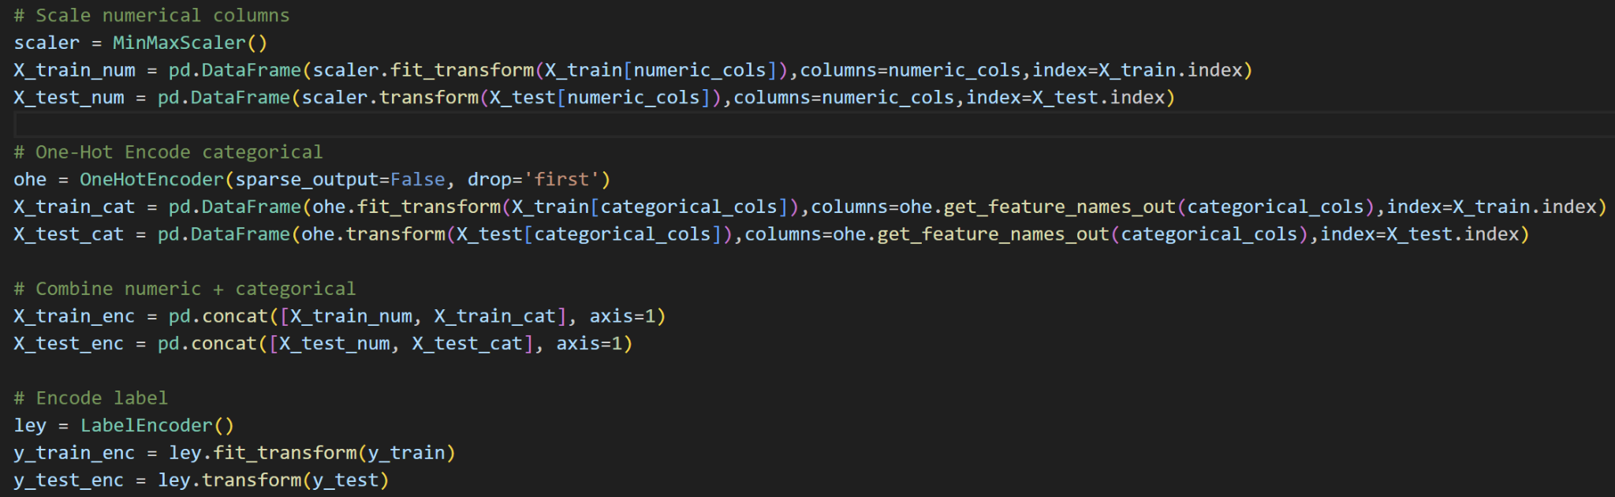
Code

Slide 19
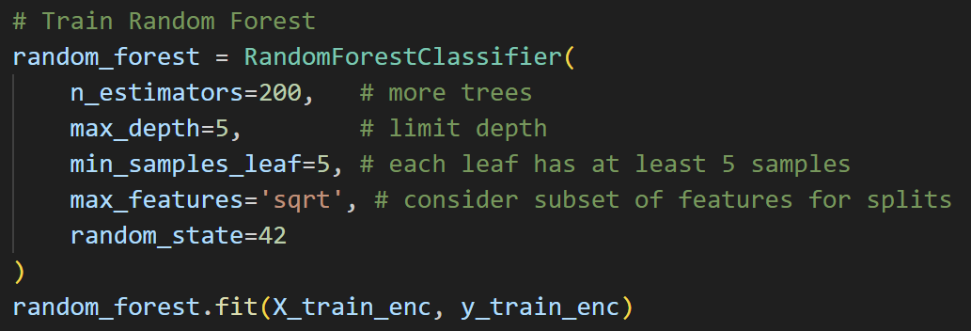
Code

Slide 20
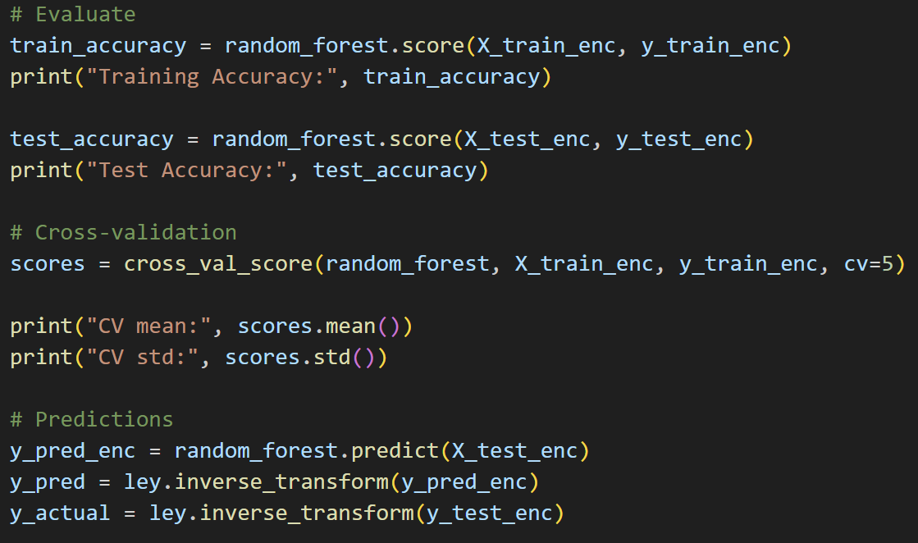
Code

Slide 21
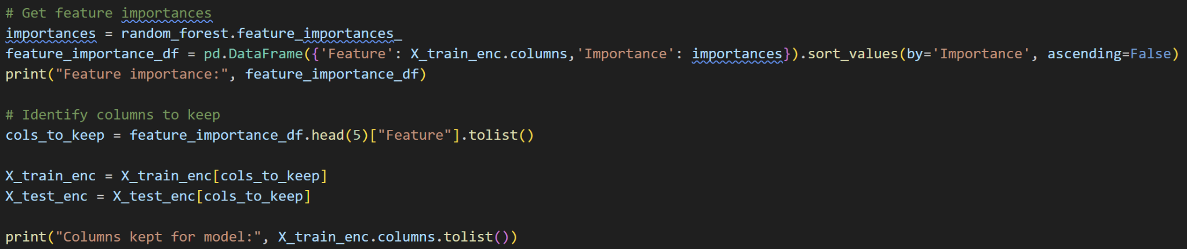
Code

Slide 22
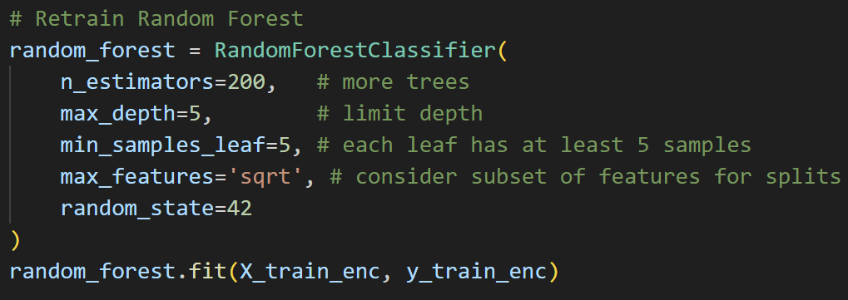
Code

Slide 23
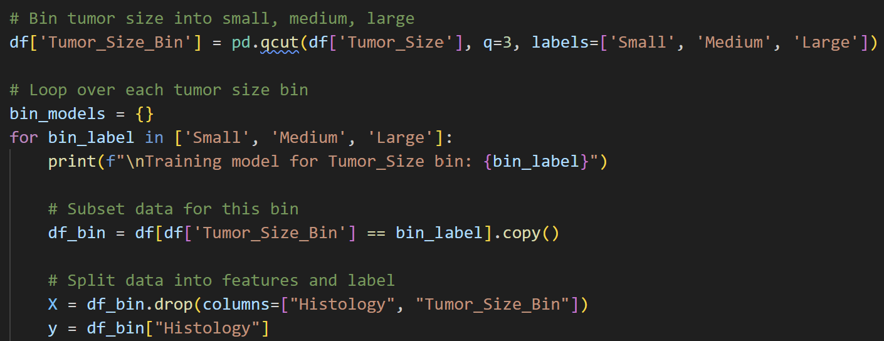
Code

Slide 24
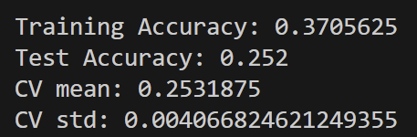
Results Without Dropped Features
Training accuracy is higher than test accuracy, showing overfitting.
The accuracy is also very low, showing that histology is likely not strongly related to the other features in our dataset.
Test accuracy is essentially the same as guessing, as there are 4 histology types.
CV mean is also around 25% and standard deviation is very low, meaning the model consistently performs poorly across different subsets.

Slide 25
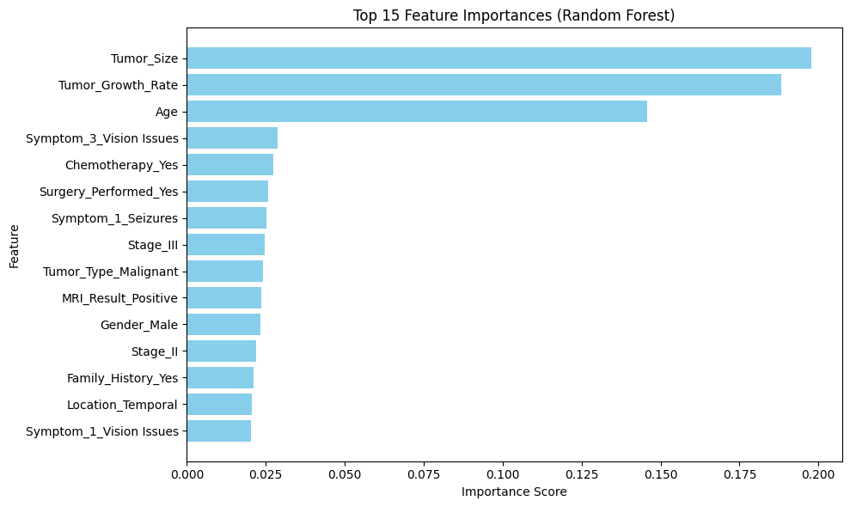

Slide 26
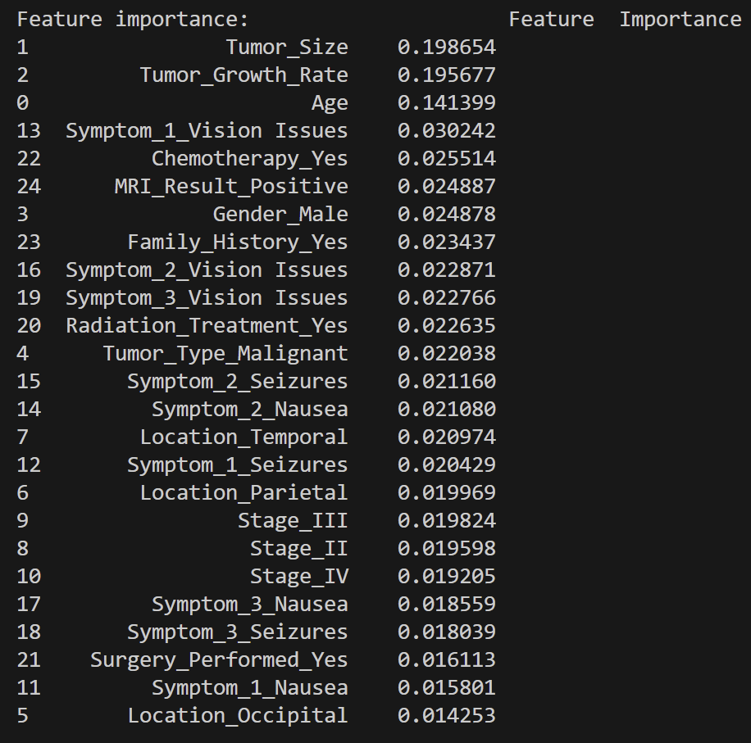
Feature Importance
We kept the top 5 features and dropped the rest.
Tumor Size, Growth Rate, and Patient Age are by far the three most important features.

Slide 27
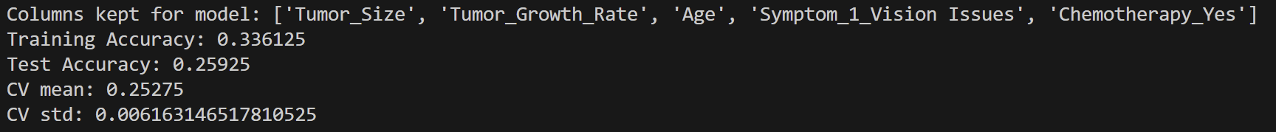
Results With Dropped Features
Accuracy is only very slightly better for the model with dropped features.
This very similar accuracy implies that dropping the unimportant features didn’t change the model’s predictive power.

Slide 28
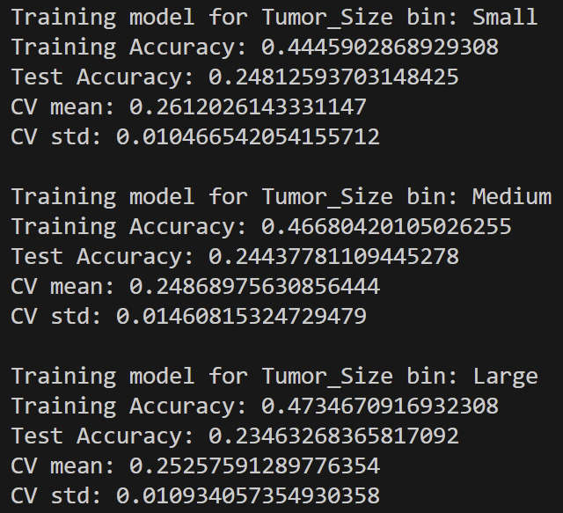
Stratified Results
We stratified the data by the most important feature: Tumor Size
The accuracies and other results are still very similar to the non-stratified dataset
The small tumor group has a slightly better accuracy than the medium and large tumor groups.

Slide 29
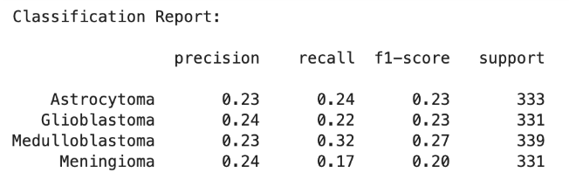
Classification Report

Slide 30
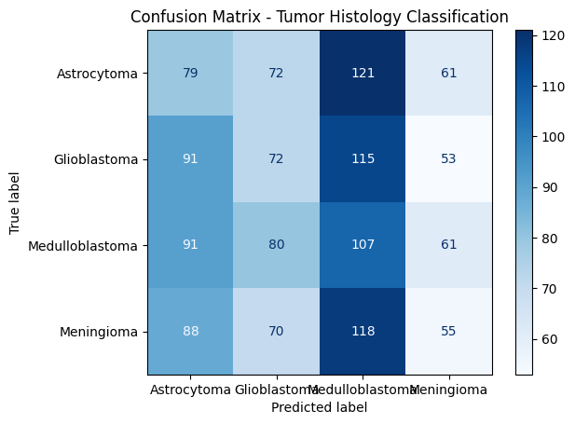

Slide 31
Conclusion
We suspect the data is machine generated, so our results do not reflect the true predictive power of our model.
We attempted to predict histology without imaging, however, it appears that these images carry essential data for classification that cannot be seen in our dataset.
Our accuracy for both the total dataset and stratified dataset are essentially the same as guessing.
In future work, we would:
Incorporate imaging features to see if our results would improve.
Collect or validate the dataset using real clinical data to ensure biological relevance.

Slide 32

Github
https://github.com/Cy-2004/DIS-ml-project

Slide 33
References
Kang, J., Ullah, Z., & Gwak, J. (2021). MRI-based brain tumor classification using ensemble of deep features and machine learning classifiers. Sensors, 21(6), 2222. https://doi.org/10.3390/s21062222
Vijithananda, P., Gunasena, T. P., Jayasekara, D., & Rajapakse, R. (2022). Feature extraction from MRI ADC images for brain tumor classification using machine learning techniques. Biomedical Signal Processing and Control, 73, 103463. https://pubmed.ncbi.nlm.nih.gov/35915448/
Shareef, M, mohsin31202. (2025, July). Brain Tumor Patient Follow-Up Prediction [Notebook]. Kaggle. https://www.kaggle.com/code/mohsin31202/brain-tumor-patient-follow-up-prediction
Phillips, J. (2025, September). Classifier Assignment [Unpublished class project]. Machine Learning, DIS Study Abroad.
Yang, C. (2025, September). Classifier Assignment [Unpublished class project]. Machine Learning, DIS Study Abroad.
OpenAI. (2025, December 2). *ChatGPT (GPT-5)* [Large language model]. https://chat.openai.com/

